Slide 1
Learning Deep Structured Semantic Models for Web Search using Clickthrough Data
Po-Sen Huang¹ Xiaodong He² Jianfeng Gao² Li Deng²
Alex Acero² Larry Heck²
¹University of Illinois at Urbana-Champaign
²Microsoft Research, Redmond, WA 98052 USA
CIKM 2013
報告者：劉憶年 2014/10/17

Slide 2
Outline
INTRODUCTION
RELATED WORK
DEEP STRUCTURED SEMANTIC MODELS FOR WEB SEARCH
EXPERIMENTS
CONCLUSIONS

Slide 3
INTRODUCTION (1/5)
However, lexical matching can be inaccurate due to the fact that a concept is often expressed using different vocabularies and language styles in documents and queries.
These latent semantic models address the language discrepancy between Web documents and search queries by grouping different terms that occur in a similar context into the same semantic cluster. Thus, a query and a document, represented as two vectors in the lower-dimensional semantic space, can still have a high similarity score even if they do not share any term.
Thus the performance of these models on Web search tasks is not as good as originally expected.

Slide 4
INTRODUCTION (2/5)
First, clickthrough data, which consists of a list of queries and their clicked documents, is exploited for semantic modeling so as to bridge the language discrepancy between search queries and Web documents.
More specifically, BLTM is a generative model which requires that a query and its clicked documents not only share the same distribution over topics, but also contain similar factions of words assigned to each topic. In contrast, the DPM is learned using the S2Net algorithm that follows the pairwise learning-to-rank paradigm outlined in [3].
Gao et al. report that both BLTM and DPM outperform significantly the unsupervised latent semantic models, including LSA and PLSA, in the document ranking task.

Slide 5
INTRODUCTION (3/5)
In the second line of research, Salakhutdinov and Hinton extended the semantic modeling using deep auto-encoders. They demonstrated that hierarchical semantic structure embedded in the query and the document can be extracted via deep learning.
As a result, the deep learning models do not significantly outperform the baseline retrieval models based on keyword matching. Moreover, the semantic hashing model also faces the scalability challenge regarding large-scale matrix multiplication.

Slide 6
INTRODUCTION (4/5)
In this study, extending from both research lines discussed above, we propose a series of Deep Structured Semantic Models (DSSM) for Web search. More specifically, our best model uses a deep neural network (DNN) to rank a set of documents for a given query as follows. First, a non-linear projection is performed to map the query and the documents to a common semantic space. Then, the relevance of each document given the query is calculated as the cosine similarity between their vectors in that semantic space.

Slide 7
INTRODUCTION (5/5)
The neural network models are discriminatively trained using the clickthrough data such that the conditional likelihood of the clicked document given the query is maximized. Different from the previous latent semantic models that are learned in an unsupervised fashion, our models are optimized directly for Web document ranking, and thus give superior performance, as we will show shortly. Furthermore, to deal with large vocabularies, we propose the so-called word hashing method, through which the high-dimensional term vectors of queries or documents are projected to low-dimensional letter based n-gram vectors with little information loss.

Slide 8

RELATED WORK -- Latent Semantic Models and the Use of Clickthrough Data
The most well-known linear projection model for IR is LSA.
In document search, the relevance score between a query and a document, represented respectively by term vectors Q and D, is assumed to be proportional to their cosine similarity score of the corresponding concept vectors and , according to the projection matrix A
Unlike latent semantic models, the translation-based approach learns translation relationships directly between a term in a document and a term in a query. Recent studies show that given large amounts of clickthrough data for training, this approach can be very effective.

Slide 9
RELATED WORK -- Deep Learning (1/2)
By exploiting deep architectures, deep learning techniques are able to discover from training data the hidden structures and features at different levels of abstractions useful for the tasks.
They proposed a semantic hashing (SH) method which uses bottleneck features learned from the deep auto-encoder for information retrieval. These deep models are learned in two stages. First, a stack of generative models (i.e., the restricted Boltzmann machine) are learned to map a term vector representation of a document layer-by-layer to a low-dimensional semantic concept vector. Second, the model parameters are fine-tuned so as to minimize the cross entropy error between the original term vector of the document and the reconstructed term vector.

Slide 10
RELATED WORK -- Deep Learning (2/2)
The first problem is that the model parameters are optimized for the reconstruction of the document term vectors rather than for differentiating the relevant documents from the irrelevant ones for a given query. Second, in order to make the computational cost manageable, the term vectors of documents consist of only the most-frequent 2000 words.

Slide 11
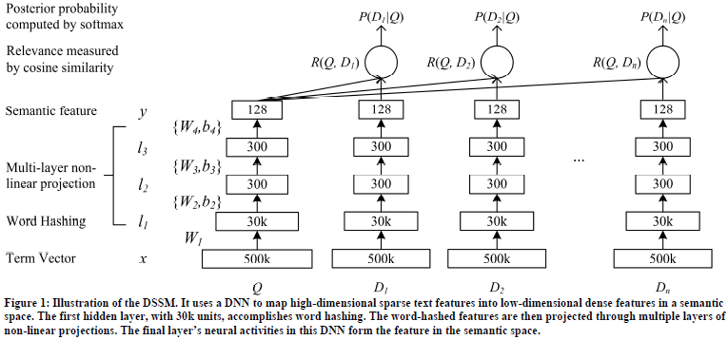
DEEP STRUCTURED SEMANTIC MODELS FOR WEB SEARCH -- DNN for Computing Semantic Features (1/3)

Slide 12


DEEP STRUCTURED SEMANTIC MODELS FOR WEB SEARCH -- DNN for Computing Semantic Features (2/3)
The input (raw text features) to the DNN is a high-dimensional term vector, e.g., raw counts of terms in a query or a document without normalization, and the output of the DNN is a concept vector in a low-dimensional semantic feature space. This DNN model is used for Web document ranking as follows: 1) to map term vectors to their corresponding semantic concept vectors; 2) to compute the relevance score between a document and a query as cosine similarity of their corresponding semantic concept vectors; rf. Eq. (3) to (5).

Slide 13
DEEP STRUCTURED SEMANTIC MODELS FOR WEB SEARCH -- DNN for Computing Semantic Features (3/3)
In Web search, given the query, the documents are sorted by their semantic relevance scores.
Conventionally, the size of the term vector, which can be viewed as the raw bag-of-words features in IR, is identical to that of the vocabulary that is used for indexing the Web document collection. The vocabulary size is usually very large in real-worldWeb search tasks. Therefore, when using term vector as the input, the size of the input layer of the neural network would be unmanageable for inference and model training. To address this problem, we have developed a method called “word hashing” for the first layer of the DNN, as indicated in the lower portion of Figure 1.

Slide 14
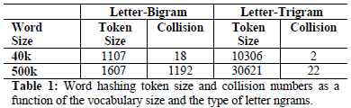
DEEP STRUCTURED SEMANTIC MODELS FOR WEB SEARCH -- Word Hashing (1/2)
The word hashing method described here aims to reduce the dimensionality of the bag-of-words term vectors. It is based on letter n-gram, and is a new method developed especially for our task.
One problem of this method is collision, i.e., two different words could have the same letter n-gram vector representation.
Compared with the original size of the one-hot vector, word hashing allows us to represent a query or a document using a vector with much lower dimensionality.

Slide 15
DEEP STRUCTURED SEMANTIC MODELS FOR WEB SEARCH -- Word Hashing (2/2)
Moreover, word hashing is able to map the morphological variations of the same word to the points that are close to each other in the letter n-gram space. More importantly, while a word unseen in the training set always causes difficulties in word-based representations, it is not the case where the letter n-gram based representation is used.
Thus, letter n-gram based word hashing is robust to the out-of-vocabulary problem, allowing us to scale up the DNN solution to the Web search tasks where extremely large vocabularies are desirable.
Since the letter n-gram vector is of a much lower dimensionality, DNN learning can be carried out effectively.

Slide 16

DEEP STRUCTURED SEMANTIC MODELS FOR WEB SEARCH -- Learning the DSSM (1/2)
The clickthrough logs consist of a list of queries and their clicked documents. We assume that a query is relevant, at least partially, to the documents that are clicked on for that query.
First, we compute the posterior probability of a document given a query from the semantic relevance score between them through a softmax function
Ideally, D should contain all possible documents. In practice, for each (query, clicked-document) pair, denoted by (Q, D⁺) where Q is a query and D⁺ is the clicked document, we approximate D by including D⁺ and four randomly selected unclicked documents, denote by {D_{j}⁻ ; j = 1, … , 4}.

Slide 17

DEEP STRUCTURED SEMANTIC MODELS FOR WEB SEARCH -- Learning the DSSM (2/2)
In training, the model parameters are estimated to maximize the likelihood of the clicked documents given the queries across the training set. Equivalently, we need to minimize the following loss function

Slide 18
DEEP STRUCTURED SEMANTIC MODELS FOR WEB SEARCH -- Implementation Details
To determine the training parameters and to avoid over-fitting, we divided the clickthrough data into two sets that do not overlap, called training and validation datasets, respectively.
The first hidden layer is the word hashing layer containing about 30k nodes (e.g., the size of the letter-trigrams as shown in Table 1). The next two hidden layers have 300 hidden nodes each, and the output layer has 128 nodes.
Word hashing is based on a fixed projection matrix. The similarity measure is based on the output layer with the dimensionality of 128.
In the training stage, we optimize the model using mini-batch based stochastic gradient descent (SGD).

Slide 19
EXPERIMENTS -- Data Sets and Evaluation Methodology (1/2)
We have evaluated the retrieval models on a large-scale real world data set, called the evaluation data set henceforth. The evaluation data set contains 16,510 English queries sampled from one-year query log files of a commercial search engine. On average, each query is associated with 15 Web documents (URLs). Each query-title pair has a relevance label.
In all experiments, we have used a 2-fold cross validation: A set of results on one half of the data is obtained using the parameter settings optimized on the other half, and the global retrieval results are combined from the two sets.

Slide 20
EXPERIMENTS -- Data Sets and Evaluation Methodology (2/2)
In our experiments, we assume that a query is parallel to the titles of the documents clicked on for that query.
However, click information is unavailable for many URLs, especially new URLs and tail URLs, leaving their click fields invalid (i.e., the field is either empty or unreliable because of sparseness).
Our research goal is to investigate how to learn the latent semantic models from the popular URLs that have rich click information, and apply the models to improve the retrieval of those tail or new URLs.

Slide 21
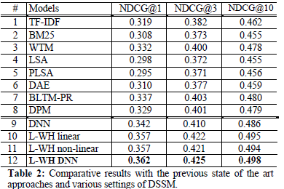
EXPERIMENTS -- Results (1/2)

Slide 22
EXPERIMENTS -- Results (2/2)
From the results in Table 2, it is also clear that supervised learning on clickthrough data, coupled with an IR-centric optimization criterion tailoring to ranking, is essential for obtaining superior document ranking performance.
Word hashing allows us to use very large vocabularies for modeling.
We also evaluated the impact of using a deep architecture versus a shallow one in modeling semantic information embedded in a query and a document.
We also have observed similar results when comparing the shallow vs. deep architecture in the case of supervised models.

Slide 23
CONCLUSIONS (1/2)
We present and evaluate a series of new latent semantic models, notably those with deep architectures which we call the DSSM.
First, we make use of the clickthrough data to optimize the parameters of all versions of the models by directly targeting the goal of document ranking. Second, inspired by the deep learning framework recently shown to be highly successful in speech recognition, we extend the linear semantic models to their nonlinear counterparts using multiple hidden-representation layers.
Third, we use a letter n-gram based word hashing technique that proves instrumental in scaling up the training of the deep models so that very large vocabularies can be used in realistic web search.

Slide 24
CONCLUSIONS (2/2)
A combination of all three sets of new techniques has led to a new state-of-the-art semantic model that beats all the previously developed competing models with a significant margin.

